Slide 1


Slide 2

Piyush Singh (2115000707) - M
Gagan Kumar (2115000392) - M
Arshit Gupta (2115000206) - M

Slide 3


Slide 4


Slide 5


Slide 6


Slide 7
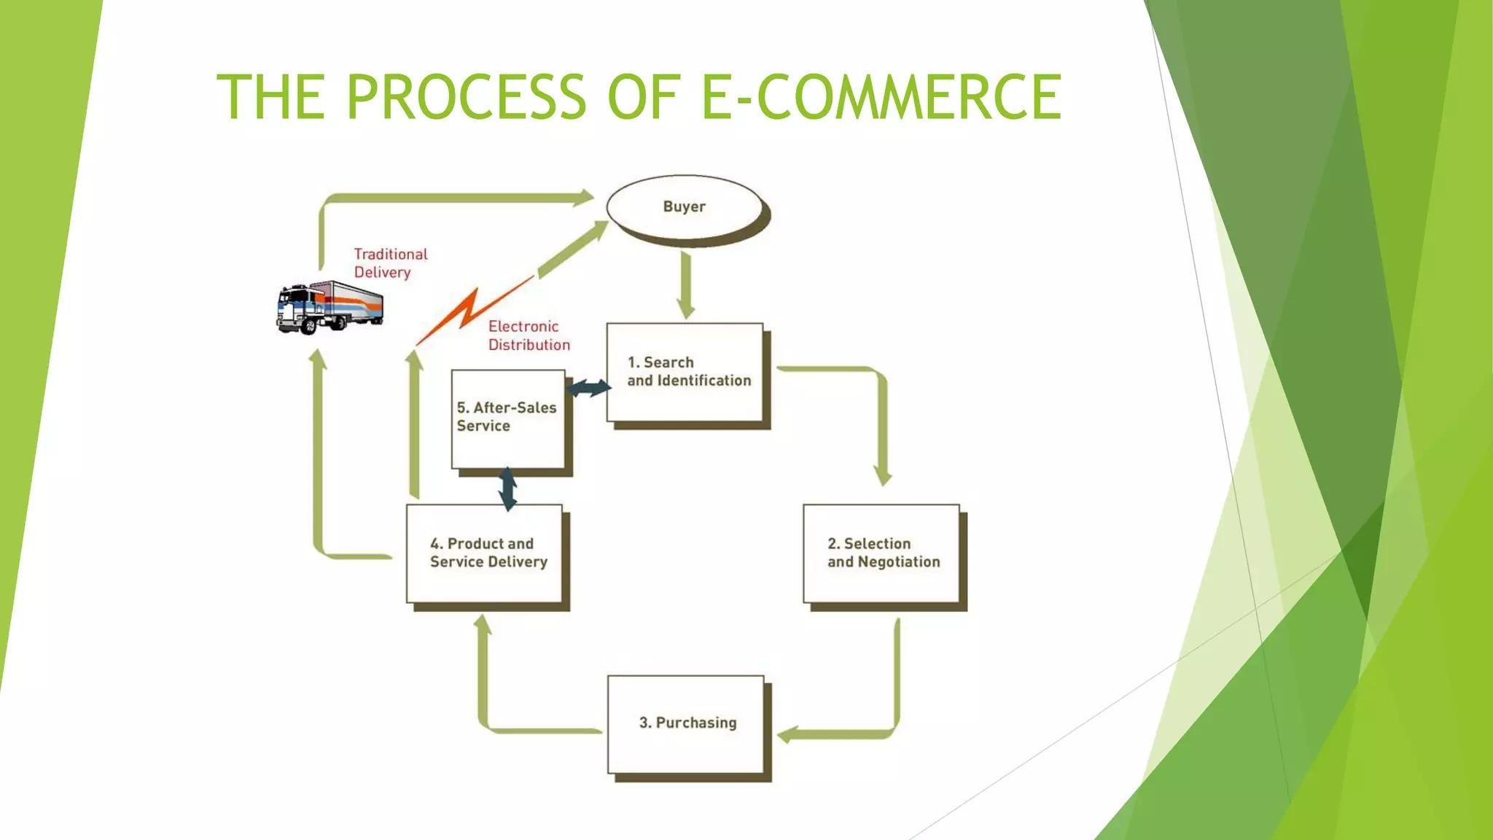

Slide 8


Slide 9


Slide 10
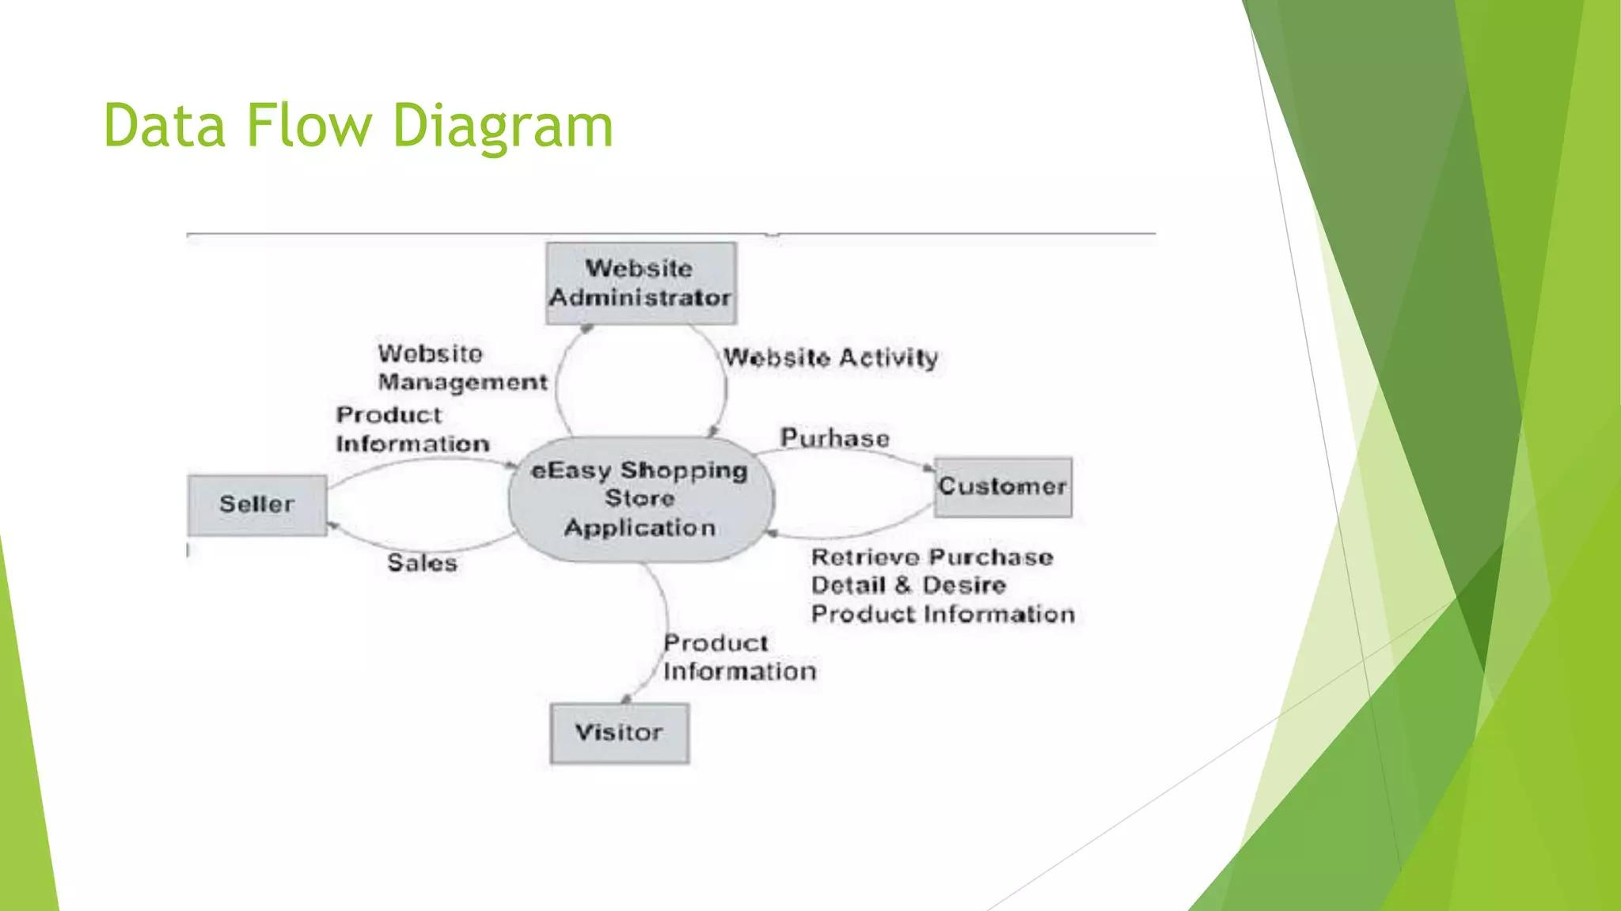

Slide 11


Slide 12
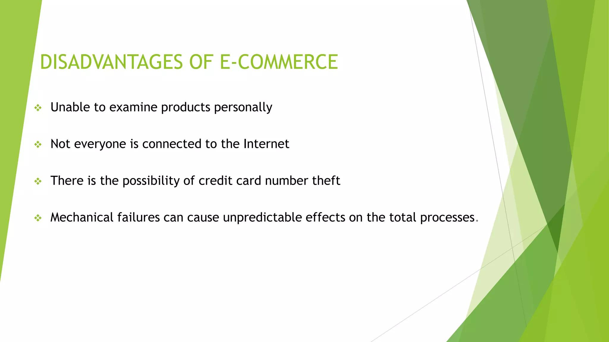

Slide 13


Slide 14


Slide 15

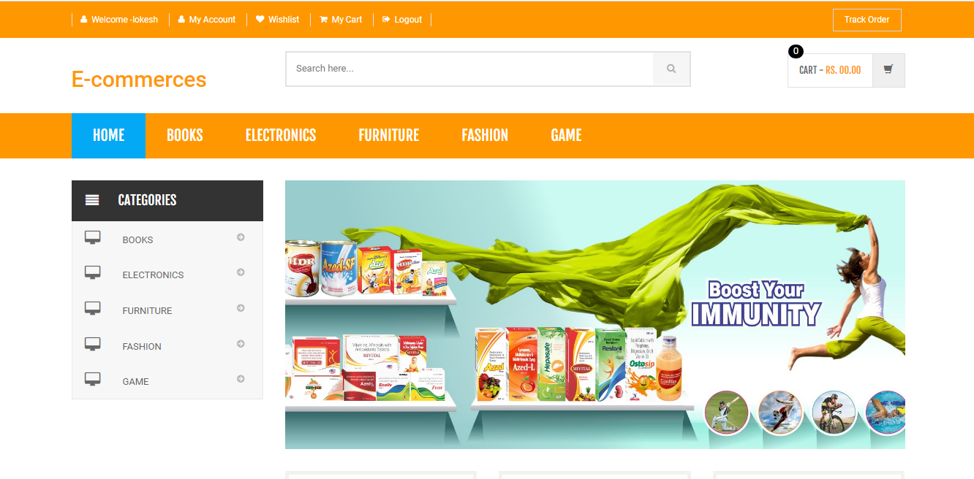

Slide 16

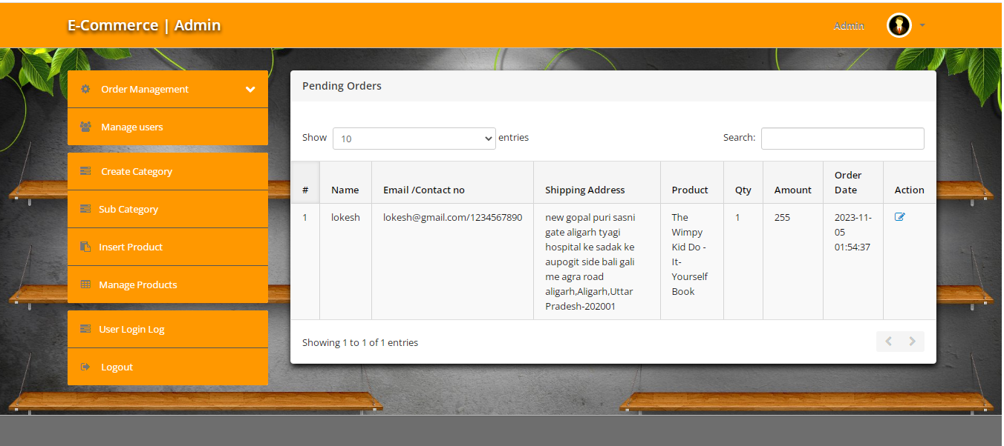

Slide 17
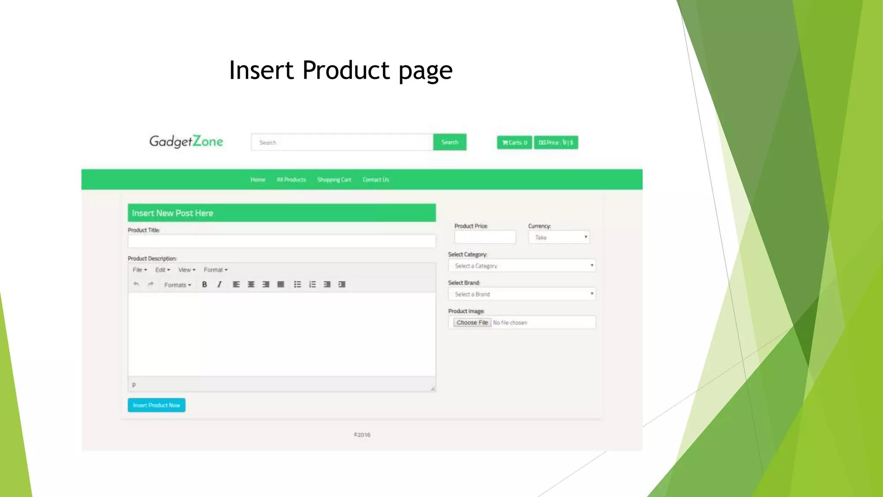
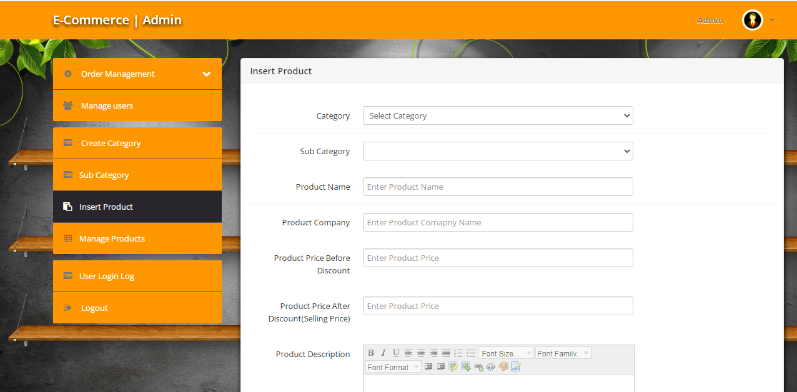

Slide 18
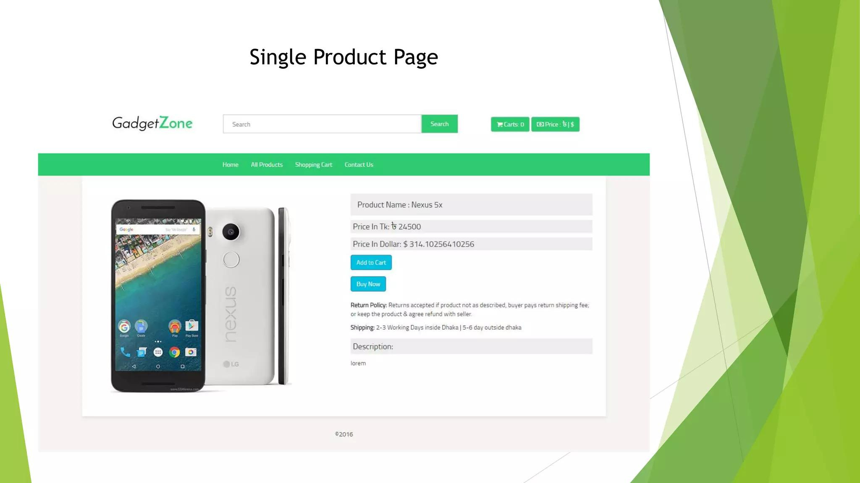
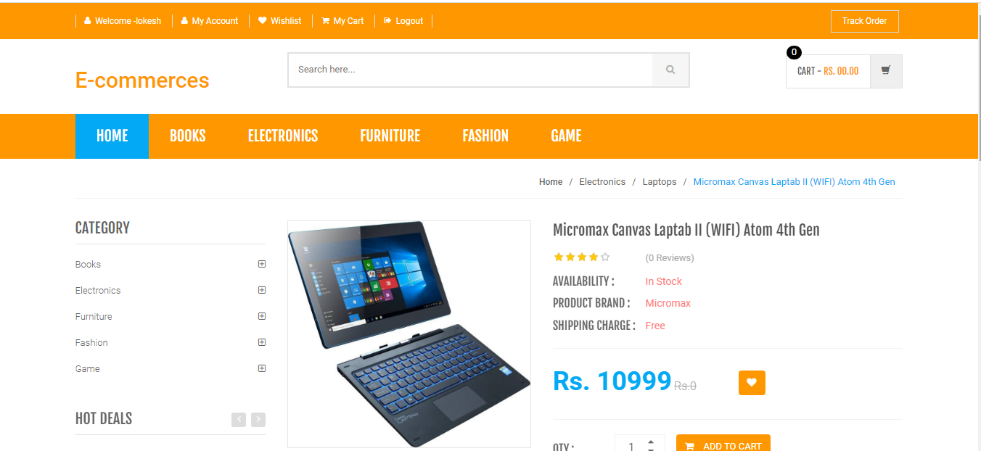

Slide 19
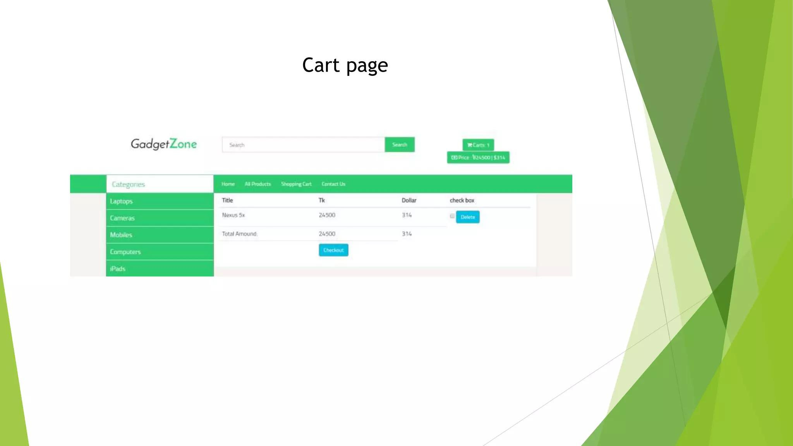
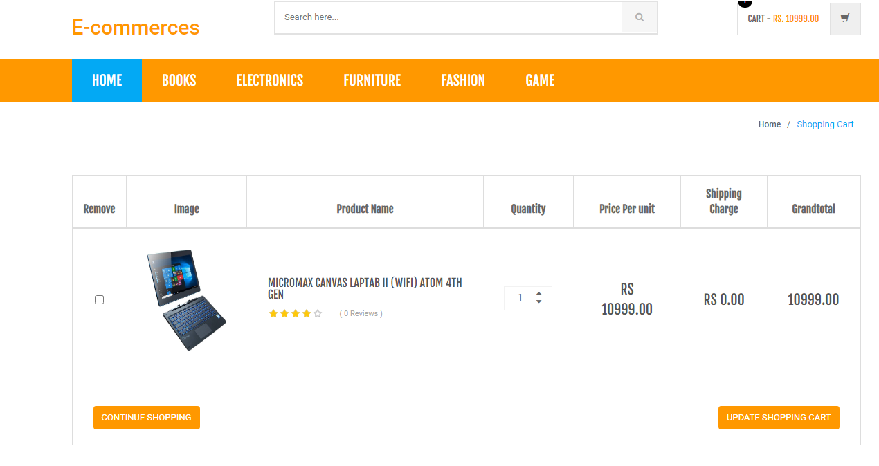

Slide 20

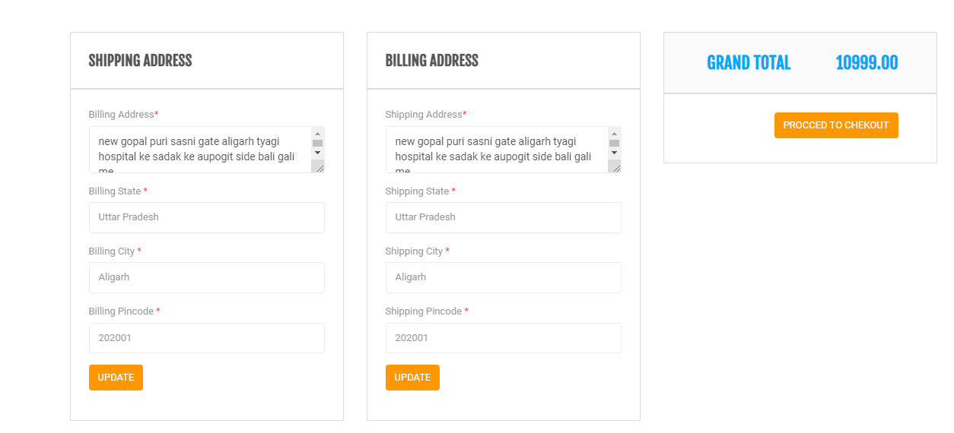

Slide 21


Slide 22


